Slide 1
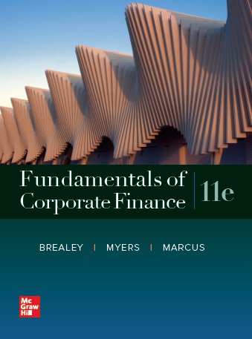
Fundamentals of Corporate Finance, 11th Edition
CHAPTER 5: The Time Value Of Money
© McGraw Hill LLC. All rights reserved. No reproduction or distribution without the prior written consent of McGraw Hill LLC.

Slide 2
Topics Covered
5.1 Future Values and Compound Interest
5.2 Present Values
5.3 Multiple Cash Flows
5.4 Reducing the Chore of the Calculations: Part 1
5.5 Level Cash Flows: Perpetuities and Annuities
5.6 Reducing the Chore of the Calculations: Part 2
5.7 Effective Annual Interest Rates
5.8 Inflation & The Time Value of Money
Notes:
2

Slide 3
Future Values and Compound Interest (1 of 8)
Future Value
Amount to which an investment will grow after earning interest
Compound Interest
Interest earned on interest
Simple Interest
Interest earned only on the original investment
Notes:
3

Slide 4
Future Values and Compound Interest (2 of 8)
Example — Simple Interest
Interest earned at a rate of 6% for five years on a principal balance of $100
$$\text{Interest} \text{earned} \text{per} \text{year}\text{ = 100 }\text{×}\text{ .06 = \$6}$$
$
$
$
Notes:
5

Slide 5
Future Values and Compound Interest (3 of 8)
Example — Simple Interest
Interest earned at a rate of 6% for five years on a principal balance of $100
Today Future Years
 | 1 | 2 | 3 | 4 | 5 | 6
Interest Earned |  | 6 | 6 | 6 | 6 | 6
Value | 100 | 106 | 112 | 118 | 124 | 130
$$\text{Value} \text{at} \text{the} \text{end} \text{of} \text{Year}\text{ 5 =} \text{\$130}$$
Notes:
12

Slide 6
Future Values and Compound Interest (4 of 8)
Example — Compound Interest
Interest earned at a rate of 6% for five years on the previous year’s balance
$$\text{Interest} \text{earned} \text{per} \text{year}\text{ = }\text{prior} \text{year} \text{balance} \text{×}\text{ .06}$$
Notes:
14

Slide 7
Future Values and Compound Interest (5 of 8)
Example — Compound Interest
Interest earned at a rate of 6% for five years on the previous year’s balance
Today Future Years
 |  | 1 | 2 | 3 | 4 | 5
Interest Earned |  | 6 | 6.36 | 6.74 | 7.15 | 7.57
Value | 100 | 106 | 112.36 | 119.10 | 126.25 | 133.82
$$\text{Value} \text{at} \text{the} \text{end} \text{of} \text{Year}\text{ 5 = \$133.82}$$
Notes:
12

Slide 8
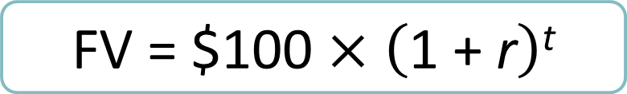
Future Values and Compound Interest (6 of 8)
Future Value = FV
$$\text{FV}\text{ = \$100 }\text{×} \left(\text{1 + }\text{r}\right)\text{t}$$
Notes:
21

Slide 9

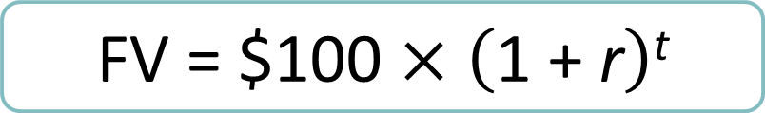
Future Values and Compound Interest (7 of 8)
Example — FV
What is the future value of $100 if interest is compounded annually at a rate of 6% for five years?
$$\text{FV}\text{ = \$100 }\text{×} \left(\text{1 + }\text{r}\right)\text{t}$$
$\text{FV}\text{ = \$100 }\text{×} \left(\text{1 + .06}\right)\text{5 }$= $133.82
Notes:
23

Slide 10
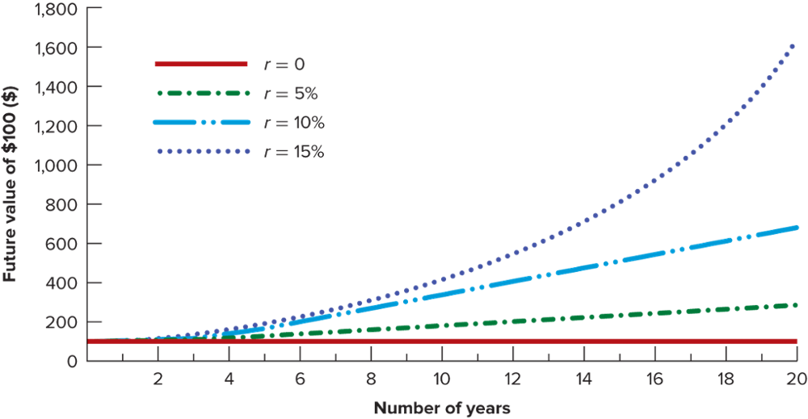
Future Values and Compound Interest (8 of 8)
Notes:
24

Slide 11
Future Values and Compound Interest (7 of 8)
Example — Future Value
Go to Excel
Notes:
23

Slide 12
Present Values
Present Value
Value today of a future cash flow
Discount Factor
Present value of a $1 future payment
Discount Rate
Interest rate used to compute present values of future cash flows
Notes:
31

Slide 13


Present Values
$\text{Present} \text{value}\text{ = }\text{PV}$
Same 4variables: PV, FV, time, interest rate
$$\text{PV}\text{ = }\frac{\text{Future} \text{value} \text{after} \text{t} \text{periods}}{\left(\text{1 + }\text{r}\right)\text{t}}$$
Notes:
32

